Slide 1


Fake News Detection
in Social Media
Using Machine Learning
Presented By
Arnab Sen Sharma
Reg : 2013331017
Maruf Ahmed Mridul
Reg : 2013331015
Supervisor
Md Saiful Islam
Assistant Professor
Department of
Computer Science & Engineering

Slide 2
OVERVIEW
Background
Definition
Existing Works
Our Plan
Our Progress So Far
Experiments
Proposed Method
Future Work
1

Slide 3
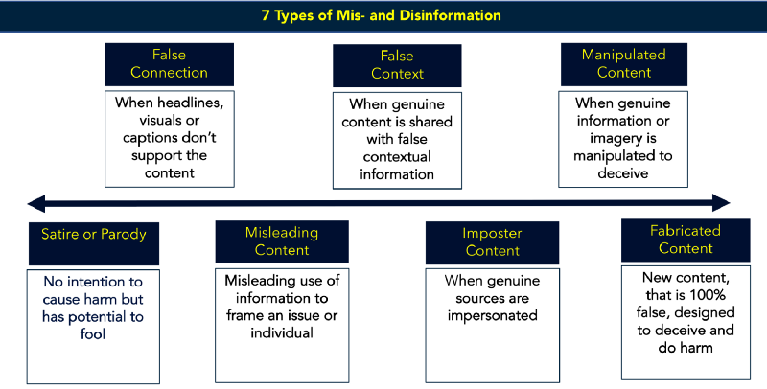
WHAT IS FAKE NEWS ?
A made up story with an intention to deceive. ( New York Times )
First Draft
2

Slide 4
WHY FAKE NEWS DETECTION?
Rapid spread of fake news should be stopped.
An automated system is needed. Because,
Human checking is too inefficient
Available web apps (Snopes.com, FactCheck.org, PolitiFact) also use human efforts
3

Slide 5
EXISTING METHODS
Fact Checking Using Linked Data [1]
Twitter Graphs [2]
Credibility Networks [3]
Naive Bayes [4][5]
CSI (Capture, Score and Integrate) Model [6]
Fact-Checking Using Likes [7]
4

Slide 6
WHAT WE WANT TO DO
The existing methods have two major limitations -
Most of those are only for Twitter
Almost each one of those uses only one feature
We target not only Twitter, but also other social media (facebook, online news portals etc. ) . And we plan to build a hybrid model using multiple features.
5

Slide 7
OUR PROGRESS SO FAR
Working around considering only body text as feature
Data Collection
Preprocessing
Experiments
6

Slide 8
DATA COLLECTION
Dataset prepared by George McIntire -
6335 labeled news articles
Dataset from Kaggle prepared by Megan Risdal
7

Slide 9
PREPROCESSING
Stop-word removal -
Removing the common words like a, an, the, and,
or etc.
Stemming -
Generalizing different forms of a word ( make,
making, made etc. actually mean the same )
'SnowballStemmer' and 'PorterStemmer' of
pythons NLTK are used.
8

Slide 10
EXPERIMENTS
Key Informations
Body text is the feature
TF-IDF is the word-embedding technique
TfidfVectorizer of Sklearn
67% of the dataset for training and 33% for primary evaluation
Naive Bayes, SVM, Random Forest, Passive Aggressive and XGBoost are implemented
9

Slide 11
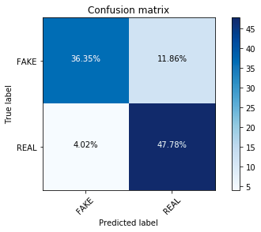
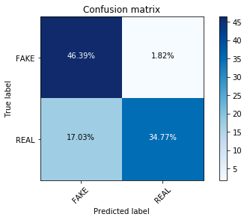
EXPERIMENTS (Cont.)
Confusion Matrices
Naive Bayes
SVM
10

Slide 12
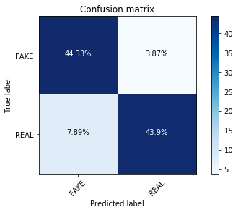

EXPERIMENTS (Cont.)
Random Forest
PAC
11

Slide 13

EXPERIMENTS (Cont.)
XGBoost
12

Slide 14
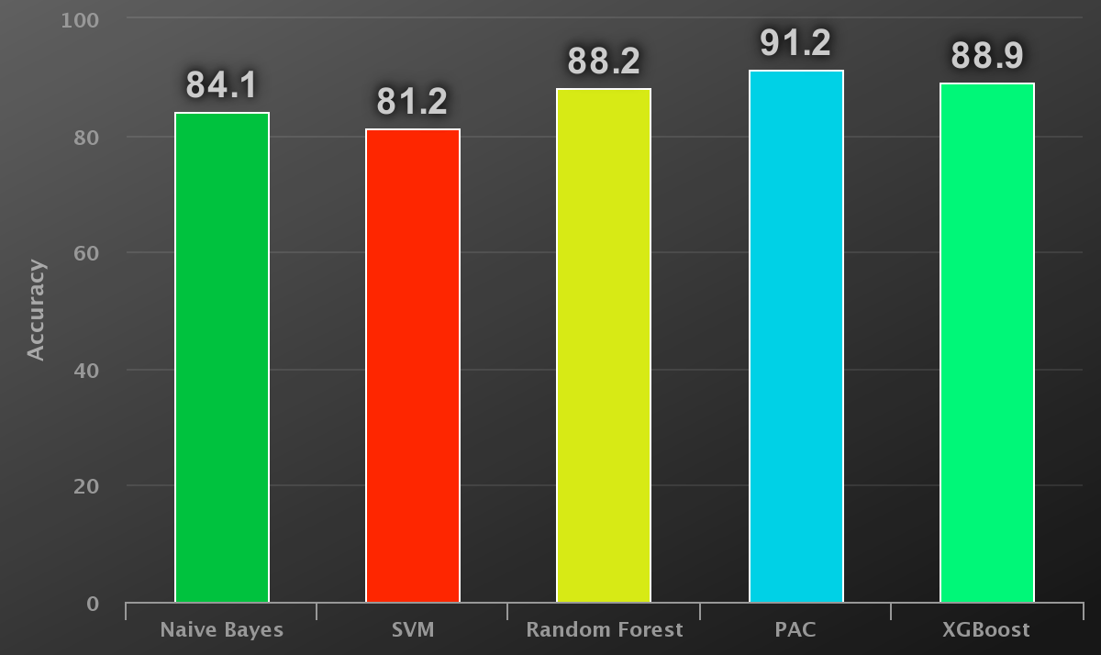
EXPERIMENTS (Cont.)
Results
Fig : Different accuracy rates against different classifiers
13

Slide 15
EXPERIMENTS (Cont.)
Critical Case
Fails to analyze semantic meaning
‘UFOs do not exist’ Will be classified as FAKE
Solution
Word2vec
Doc2vec
14

Slide 16
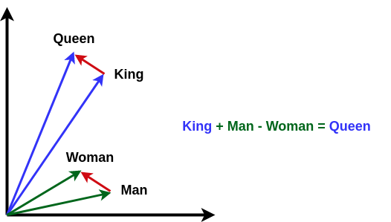
EXPERIMENTS (Cont.)
Word2vec
Skip-gram
Continuous Bag Of Words (CBOW)
15

Slide 17
EXPERIMENTS (Cont.)
Word2vec for Documents
2D Vector for a document
Conversion from 2D to 1D
Mean
m*n to 1*mn
Combination of mean value and tf-idf
16

Slide 18
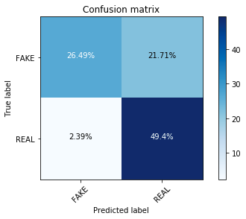
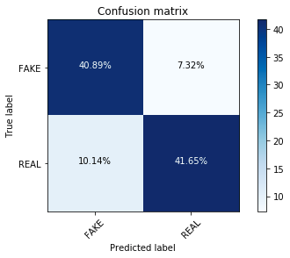
EXPERIMENTS (Cont.)
Confusion Matrices
Word2vec - PAC
Word2vec - XGBoost
17

Slide 19
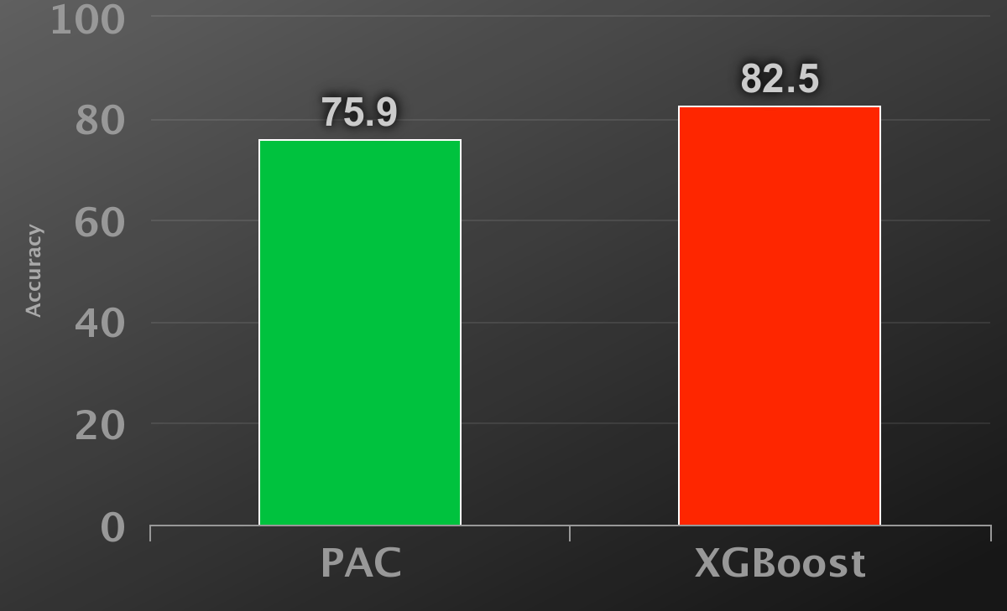
EXPERIMENTS (Cont.)
Word2vec Results
18

Slide 20
EXPERIMENTS (Cont.)
Doc2vec
An approach based on word2vec that embeds a document to a vector
19

Slide 21
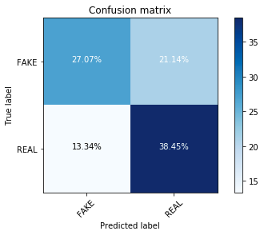
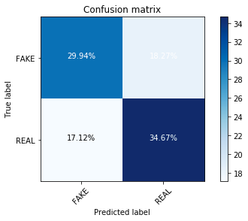
EXPERIMENTS (Cont.)
Confusion Matrices
Doc2vec - PAC
Doc2vec - XGBoost
20

Slide 22
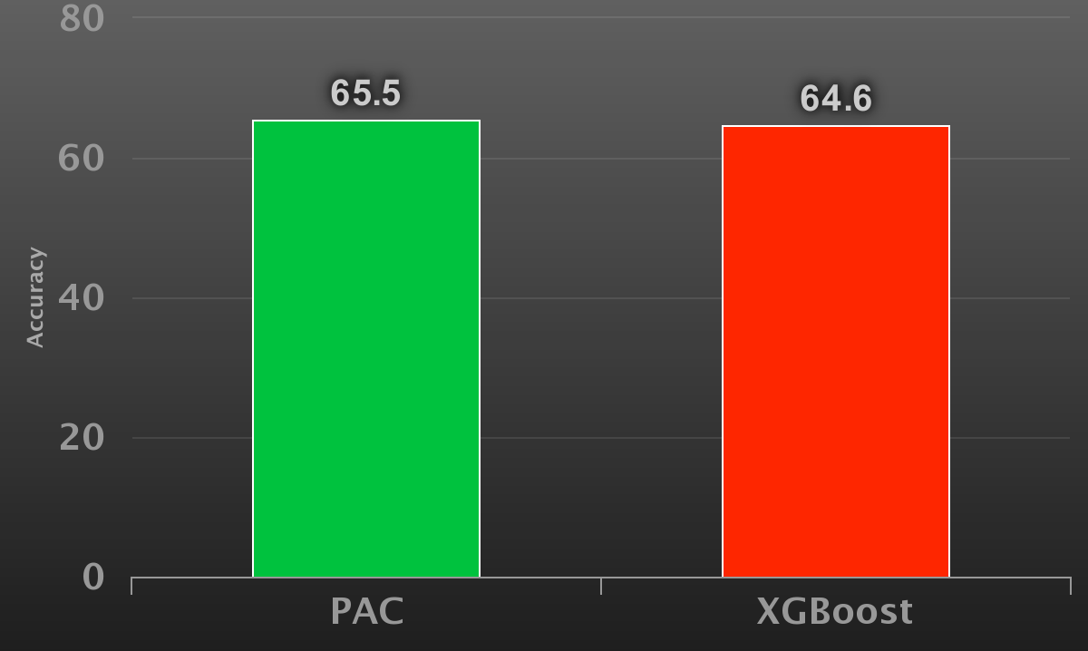
EXPERIMENTS (Cont.)
Doc2vec Results
21

Slide 23
So, only body text is not enough
22

Slide 24
PROPOSED METHOD
More features
Headline
Source
Likes
Comments
23

Slide 25
PROPOSED METHOD (Cont.)
Working with The Headline
Preprocessing
Finding the relationship between the headline with the body text
Using PAC, CNN, RNN
Fake
Yes
Completely Disagree ?
Headline
Relation with Body Text
Real
No
24

Slide 26
PROPOSED METHOD (Cont.)
Working with The Source
Finding the number of real and fake news from the source
Logistic regression
Logistic regression
D
Source
25

Slide 27
PROPOSED METHOD (Cont.)
Working with Likes
Tagging users as real or fake likers
Finding the number of likes got from real and fake likers
Logistic regression
Logistic regression
C
Likes
26

Slide 28
PROPOSED METHOD (Cont.)
Working with Comments
Preprocessing
Using PAC, CNN, RNN
PAC
1 or -1
Maximum Vote
Comments
B
CNN
1 or -1
RNN
1 or -1
27

Slide 29
PROPOSED METHOD (Cont.)
Working with Body Text
Preprocessing
Using PAC, CNN, RNN
PAC
1 or -1
Maximum Vote
Body Text
A
CNN
1 or -1
RNN
1 or -1
28

Slide 30
PROPOSED METHOD (Cont.)
Final Result Calculation
A, B, C, D are either 1 ( real ) or -1 ( fake )
W = 0.5*A + 0.2*B + 0.2*C + 0.1*D
W >= 0 means Real and W < 0 means Fake
29

Slide 31
PROPOSED METHOD (Cont.)
Let’s get to the big picture...
30

Slide 32
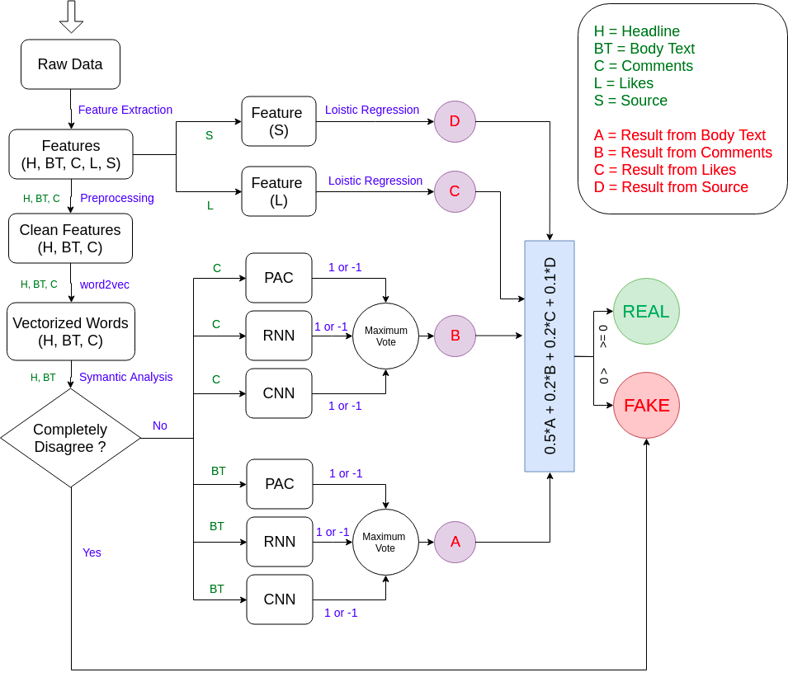
31

Slide 33
FUTURE WORKS
More data collection
Implementation of the proposed method
Improvement of the proposed method
And finally,
To do the task for bilingual news, specially for Bangla
32

Slide 34
REFERENCES
[1] Y. C. Niall J. Conroy, Victoria L. Rubin, “Automatic deception detection:
Methods for finding fake news,” vol. 52, pp. 1–4, 01 2015.
[2] J. G. Cody Buntain, “Automatically identifying fake news in popular twitter
threads,” 2017.
[3] Y. Z. J. L. Zhiwei Jin, Juan Cao, “News verification by exploiting conflicting
social viewpoints in microblogs,” 2016.
[4] V. M. Mykhailo Granik, “Fake news detection using naive bayes classifier,” 2017.
[5] F. R. Inggrid Yanuar Risca Pratiwi, Rosa Andrei Asmara, “Study of hoax news
detection using naive bayes classifier in indonesian language,” 2017.
[6] Y. L. Natali Ruchansky, Sungyong Seo, “Csi: A hybrid deep model for fake news
detection,” 11 2017.
[7] M. L. D. V. S. M. L. d. A. Eugenio Tacchini, Gabriele Ballarin, “Some like it hoax:
Automated fake news detection in social networks,” 4 2017
33

Slide 35
Thank You

Slide 36
Questions and Suggestions ?

